Slide 1

IN-PATIENT STAY PREDICTION
By
Narendra Gude
Priya Kaur Randhawa
Sai Narayana Das

Slide 2
Aim: Explore and predict the length of stay of the patients in the hospital.
What exactly is LOS?
Length of stay (LOS) is a clinical metric that measures the length of time elapsed between a patient’s hospital admittance and discharge.

Slide 3
LONG-TERM GOALS: Improving the quality of patient care. Reducing healthcare costs. Optimizing hospital operations.
MAJOR APPLICATIONS:
Resource allocation
Discharge planning
Clinical decision making
Quality improvement

Slide 4
DATASET The original data is from HealthData: Hospital Inpatient Discharges (SPARCS De-Identified)(https://healthdata.gov). The data provided is based on this, with some modifications. The attributes are ID, HealthServiceArea, Gender, Race, TypeOfAdmission, CCSProcedureCode, APRSeverityOfIllnessCode, PaymentTypology, BirthWeight, EmergencyDepartmentIndicator, AverageCostinCounty, AverageChargesInCounty, AverageCostInFacility, AverageChargesInFacility, AverageIncomeInZipCode, and a Target Variable LengthOfStay.
Kaggle link: https://www.kaggle.com/datasets/narendragude/in-patient-stay-prediction

Slide 5
Workflow
Importing libraries
Creating functions for preprocessing
Importing the train and test data
Exploring train data
Splitting the independent and target attribute
Encoding the categorical attributes
Data splitting
Feature scaling
Performance metrics
Modeling
Selecting the model
Predicting for unseen data

Slide 6
Pre-processing
The preprocessing steps are necessary to transform the data into a suitable format for the machine learning algorithm to learn from. Applicable to both training and test data
Data cleaning:
‘cleaning_values’ – Gender ‘U’ to most commonly gender, and paymentTypology from ‘unknown’ to ‘miscellaneous/other’
Data Transformation:
‘change_dtype’ – CCSProcedureCode to object
‘encoding’ – encode the categorical variables to numerical using one hot encoder
‘test_encoding’ – encodes the features of test data using encoder
Data reduction: ‘drop_columns” – ‘HealthServiceArea’

Slide 7
Importing the train and test data We import the train and test data. We do EDA, modelling and then select the best model for deployment. The test dataset on which the model selected will be applied.
Exploring Train Data
Exploring few observations – Attributes not required for modeling can be removed.
Exploring the attributes of the dataframe like exploring the categorical attributes, exploring the numerical attributes, exploring target variable.

Slide 8
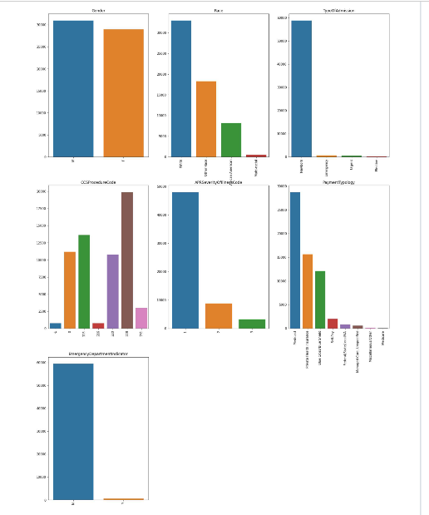
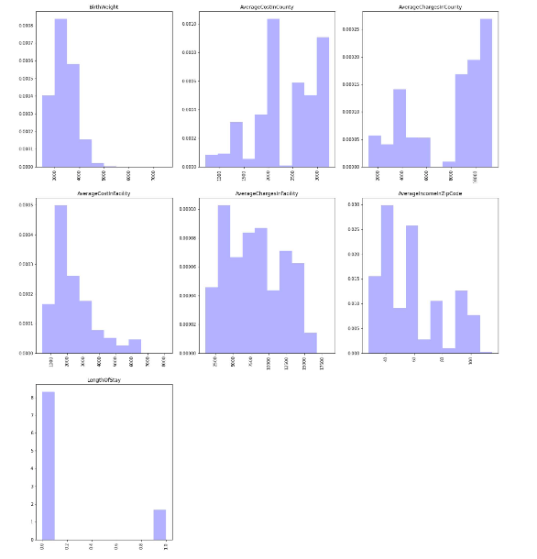
Distribution of the variables
Distribution of categorical attributes
Categorical variables – Bar plot – understand the count of each levels in an
attribute.
Variables - Gender, race, TypeOfAdmission, CCSProcedureCode,
APRSeverityofIllnessCode, PaymentTypology,
EmergencyDepartmentIndicator.
Interpretation:
Discrepancies in EmergencyDepartmentIndicator and TypeOfAdmission.
This means the model built would predict more accurately when the
TypeOfAdmission is ‘newborn’ and EmergencyDepartmentIndicator is’N’
As there are more training records.
Distribution of numerical attributes
Numerical variables- Histogram.
Variables - Birthweight, AveragecostinCounty, AverageChargesinCounty,
AverageCostinFacility, AverageChargesInFacility, AverageIncomeInZipcode,
LengthOfStay.
Interpretation:
The numerical variables have different ranges which can bring bias in
the model. The data is spread out which is explained by high variance
there is some skewness in the distribution of many attributes.

Slide 9
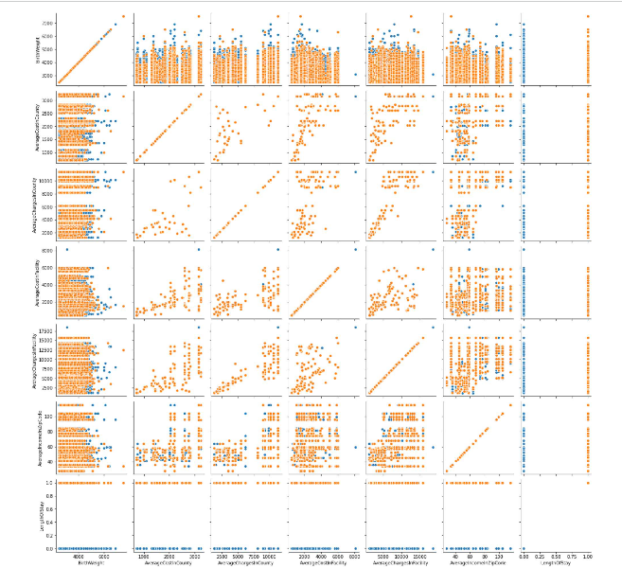
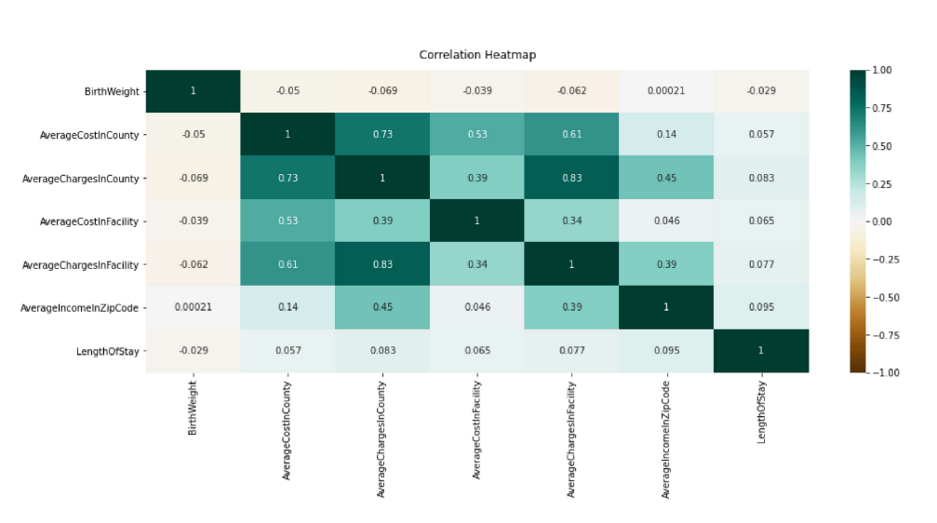
Relationship between Independent and Target variable
Scatter plot for numerical attributes
The pair plot does not show any kind of correlation or any
sort of linear relationship between attributes.
The main insight is that the target feature cannot be
linearly separated.
We need a non-linear boundary to separate the model.
Correlation matrix for numerical attributes
Most of the attributes exhibit less correlation with each other and
with target variable as well.

Slide 10
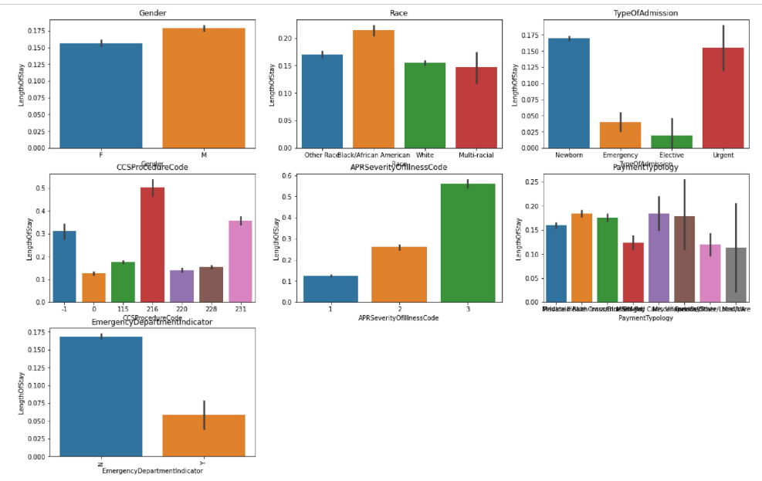
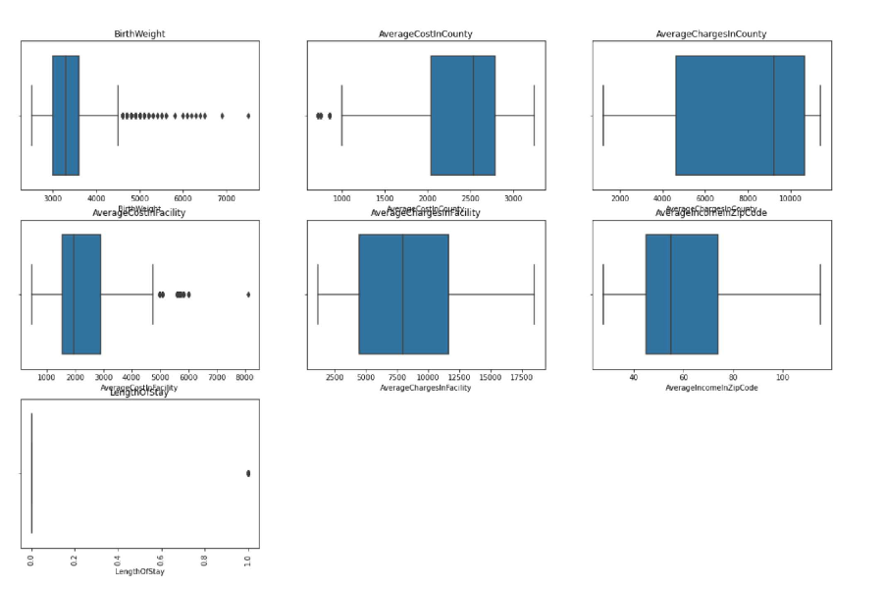
Bar plot for categorical attributes
For Gender, Race, PaymentTypology, the LOS remains more or less
the same for all levels of attributes.
For TypeOfAdmission, the length of stay tends to be high for urgent
and Newborn types.
Exploring outliers
Birthweight has many outlier values.
We are not treating outliers because for example there are
newborn babies who are in general born under or overweight,
which needs immediate care for which LOS increase

Slide 11
Splitting the independent and target variable Before we proceed with the modeling, we will segregate the independent and dependent variable.
Encoding the categorical attributes
To encode the categorical variable , we will use the one hot encoding technique.

Slide 12

Data splitting
Since the size of the dataset is close to 60,000 records, doing hold out validation split is possible, since there would be good amount of data in the validation and test data, giving enough confidence in the performance of the model. The distribution is almost same in all the 3 different datasets.
Size of train data:(33717, 34)
Size of validation data:(11239, 34)
Size of test data:(14986, 34)

Slide 13
Feature scaling
The dataset is not separated by the linear boundary for the target feature, we will be using the Decision Tree and Random Forest models to provide a non-linear boundary to separate the target feature.
However, since we are proceeding with Decision Tree and Random Forest, there is no need to do scaling, as these models are not influenced by the different ranges of the attribute.
That's why Feature scaling is avoided and normalization to reduce skewness as well.

Slide 14

Performance metrics
Since the target feature, in the dataset, has class imbalance problem ( records for patients staying less than 4 days is more than patients staying for more than 4 days), accuracy score is not a good judgement to use.
For this kind of scenario, we will use the f1 score.
Since our dataset has the class imbalance issue, we will work with the average="weighted" in the f1_score(), since weighted takes the class imbalance into account, while calculating the score.

Slide 15
Training the model
For this particular classification problem, we will be using Decision Tree and Random Forest.
Reason:
Looking at the EDA, the target feature is not linearly separable, so using any model which needs linearity is eliminated. So logistic regression, is not good for this problem.
Also, looking at the correlation matrix, the independent features (numerical) did not exhibit any linear relationship with the target feature.
Since, our dataset contains categorical features as well, the best algorithm suitable for this kind of problems is Decision Tree and Random Forest.

Slide 16
Decision tree
Base Decision Tree model:
Train f1 score: 0.959
Validation f1 score: 0.771
Looking at the accuracy score and the f1-score of the model, there seems to be a case of overfitting.
The base model overfits based on the validation data, we will optimize the model by hyper parameter tuning.
Optimized decision tree:
Train f1-Score: 0.754
Validation f1-score:0.741
f1 score on the test data: 0.747
Looking at the optimized Decision Tree with criterion = "entropy", max_depth = 6, min_samples_split=2, class_weight="balanced", this model's performance on the test data is doing good, giving an f1 score of 0.748 on the test data.
Also, optimized decision tree is performing better in comparison to base decision tree with no case of overfitting. So, the optimized decision tree is chosen to represent the decision tree.

Slide 17
Random Forest
Base Random Forest Model
Train f1 score: 0.960
Validation f1 score: 0.790
Looking at the performance of the Base Random Forest, there's a clear case of overfitting, just like the base decision tree model, which needs to be addressed using the hyper parameter tuning.
Also, there's no need to look at the performance of the model on test data, as it will clearly overfit.
Since there is overfitting, we will try to optimize the model by hyper parameter tuning.
Optimized Random Forest Model
Train F1-Score score: 0.783
Validation F1-Score score: 0.762
F1 score on the test data: 0.76
Looking at the optimized Random Forest, with max_depth = 10, min_samples_split = 2, n_estimators = 500, the performance on the test data is better than the base random forest classifier.
Optimized Random Forest is better than the base model, as there is no case of overfitting, looking at the f1 scores.
So, this optimized model is chosen to represent the random forest.

Slide 18
Selecting the model
Both optimized Decision Tree and Opitimized Random Forest gives good result in terms of f1 score and confusion matrix as well.
However, optimized Random Forest model produces better f1 score on the test data.
Looking at the confusion matrix, Random Forest is better in classifying the positive cases, i.e., patients staying for more than 4 days.
So, looking at all the parameters, the optimized random forest works better for this particular task and will be using it for predicting the values for unseen data.
 | Optimized Decision Tree | Optimized Random forest
Parameters | criterion="entropy", max_depth = 6, min_samples_split=2, class_weight="balanced" | Parameters: criterion="gini", max_depth = 10, min_samples_split=2, n_estimators=500
F1 Score on Train Data | 0.754 | 0.78
F1 Score on Validation Data | 0.74 | 0.76
F1 Score on Test Data | 0.74 | 0.76

Slide 19

Thank you

